Slide 1
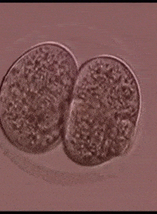
Fertilisation and early development
AEHBY Human Biology

Slide 2
Review
On the diagram you have been given:
Label a) progesterone b) oestrogen c) LH and d) FSH (4)
Label a) the luteal phase and b) the follicular phase (2)
Indicate when a) menstruation b) ovulation and c) peak fertility would occur. (3)
Underneath the graph, sketch the matching sequences of the ovarian cycle. (4)

Slide 3
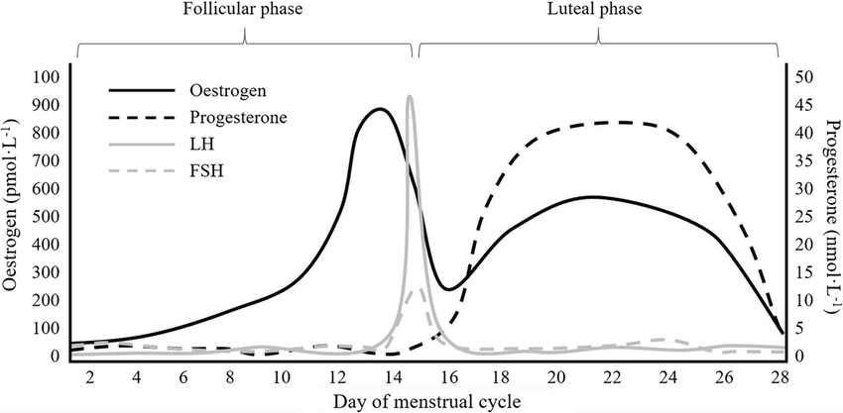
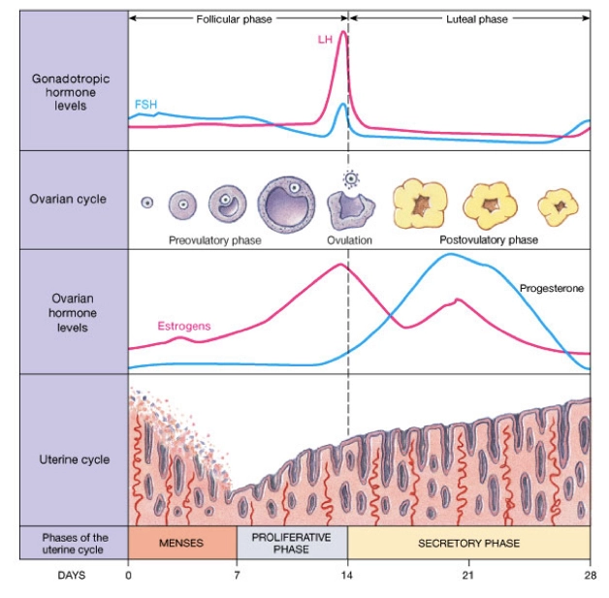
Ovulation
Menstruation
Fertile

Slide 4
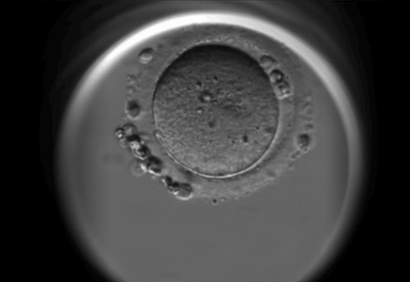
Learning Intentions
For the establishment of a pregnancy, conception requires the union of viable sperm and ovum at the optimal time in the ovarian cycle
The development of the embryo after implantation involves the differentiation of cells into three different germ layers that will eventually produce specific systems in the body and the placenta

Slide 5
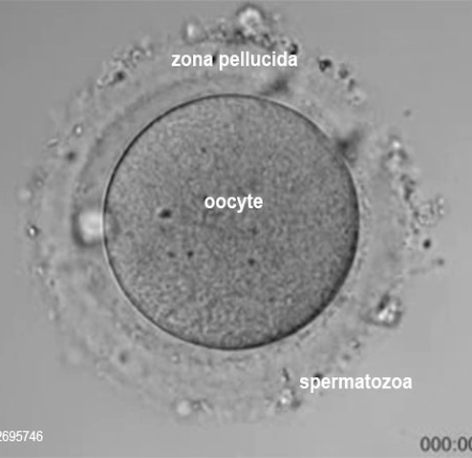
Success criteria
Define fertilisation.
Identify peak fertility of the menstrual cycle and relate to viable lifespan of sperm and ova.
Classify the baby’s development as germ stage, embryonic stage or foetal stage.
Draw, label or describe oocyte, zygote, morula and blastocyst. Compare hormonal and ovarian cycle with and without fertilization

Slide 6
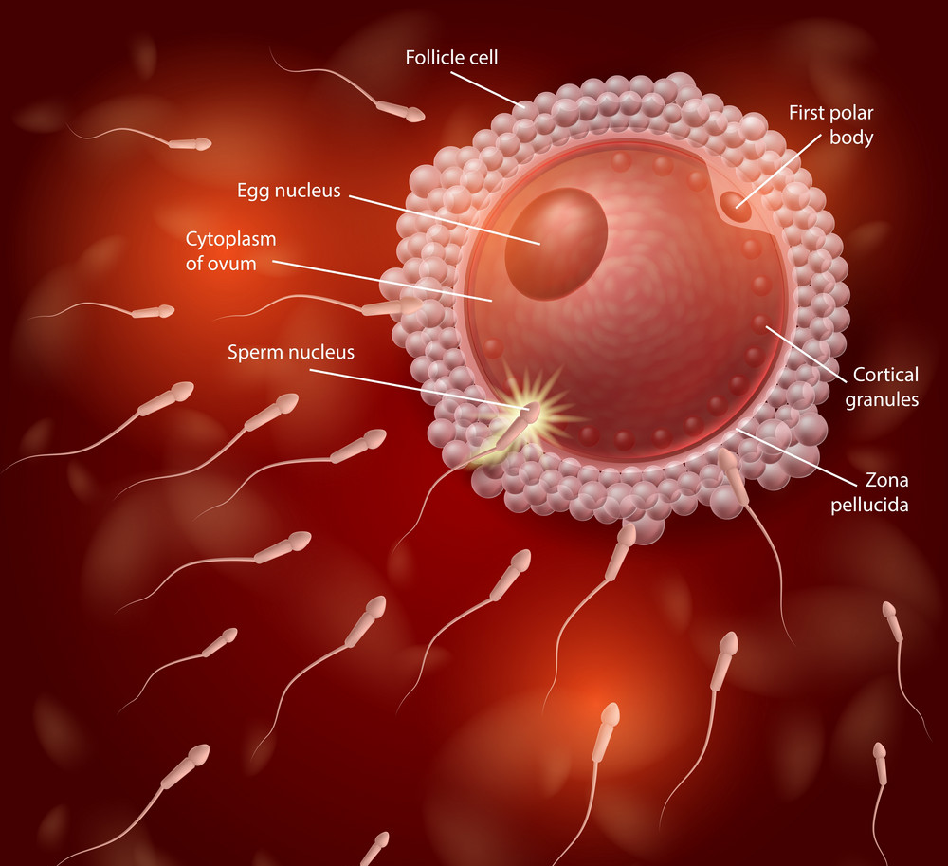
Fertilisation
The oocyte is viable for 12-24 hours after it is released from the ovary.
Sperm are viable for 12-48 hours (up to 72 hours) within the female reproductive tract.
The exact moment that the sperm’s genetic material enters the ovum, fertilisation has occurred and a zygote is formed.

Slide 7
Ovulation
Menstruation
Fertile

Slide 8
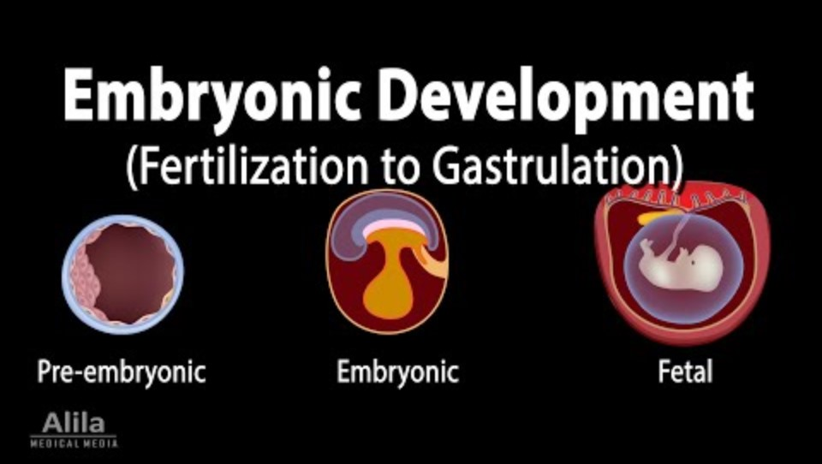

Slide 9
The germ stage
Rapid mitotic division or cleavage occur after fertilisation. With little time for G phases, the cells become smaller and smaller, but the increased surface area to volume ratio assists the cells to absorb nutrients and oxygen and dispose of wastes.

Slide 10
Initially forming a bundle of cells called a morula, by the 4th or 5th day after fertilisation, about 100 cells form a hollow ball within the degenerating zona and the bundle of cells, called a blastocyst float freely inside the uterus. On the 6th day the blastocyst adheres to the endometrium and begins to implant.

Slide 11
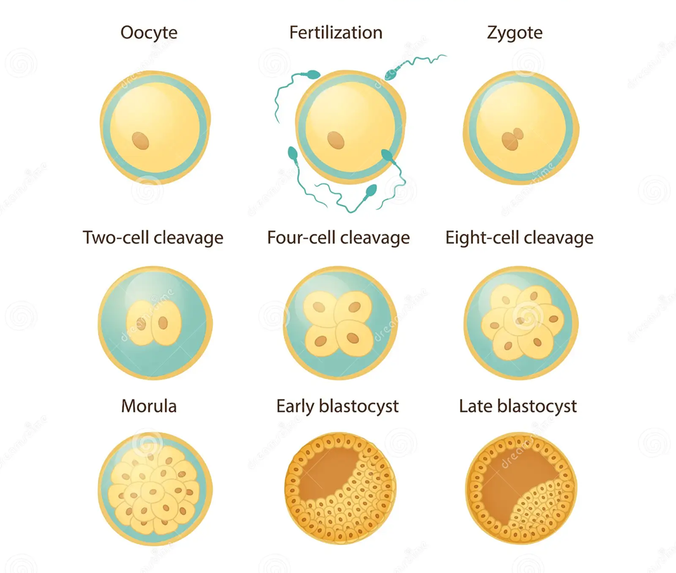

Slide 12
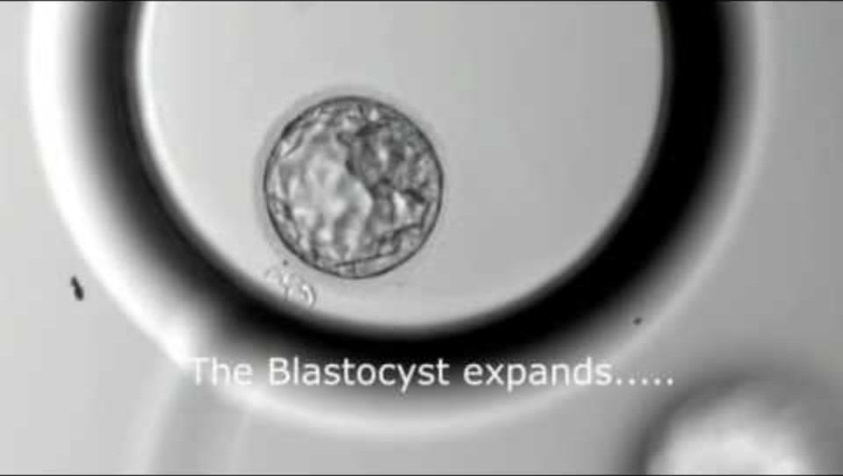

Slide 13
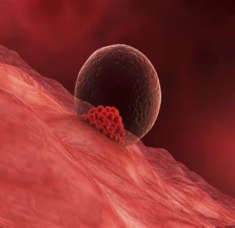
Implantation
By the 14th day, the blastocyst secretes Human Chorionic Gonadotropic (HCG) which prompts the corpus luteum to continue its production of progesterone and oestrogen, suppressing the next ovulation and maintaining the endometrium.
HCG in the mother’s blood and urine allow pregnancy to be detected.
Once implanted, the embryonic phase begins.

Slide 14
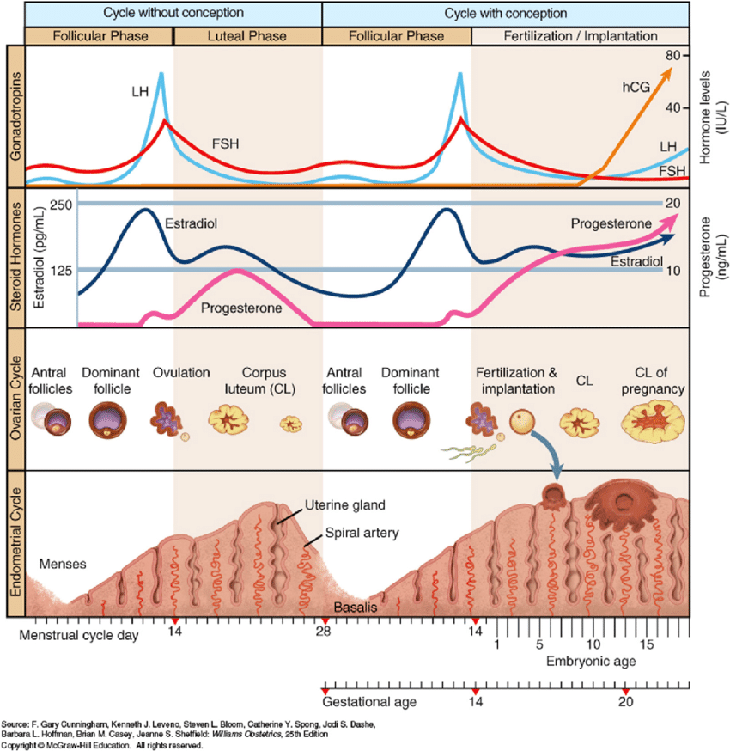

Slide 20
Success criteria
Define fertilisation.
Identify peak fertility of the menstrual cycle and relate to viable lifespan of sperm and ova.
Classify the baby’s development as germ stage, embryonic stage or foetal stage.
Draw, label or describe oocyte, zygote, morula and blastocyst. Compare hormonal and ovarian cycle with and without fertilization.

